Slide 1
COMPUTER ORGANIZATION AND ARCHITECTURE
Dr. Rizwan Khan
Head – Department of Computer Science and Engineering
(An NBA Accredited Program)
ABES Institute of Technology, Ghaziabad

Slide 2
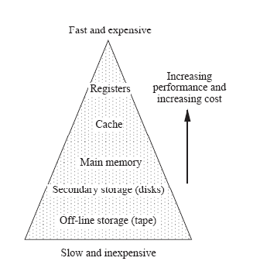
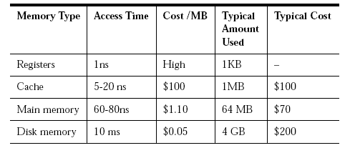
Cache In The memory hierarchy
Cache memory has the fastest access time after registers.

Slide 3
Why is cache memory needed?
When a program references a memory location, it is likely to reference that same memory location again soon.
A memory location that is near a recently referenced location is more likely to be referenced then a memory location that is farther away.

Slide 4
Why is cache memory needed
A small but fast cache memory, in which the contents of the most commonly accessed locations are maintained, can be placed between the CPU and the main memory.
When a program executes, the cache memory is searched first.

Slide 5
Why is cache memory fast?
Faster electronics used
A cache memory has fewer locations than a main memory, which reduces the access time
The cache is placed both physically closer and logically closer the the CPU than the main memory

Slide 6
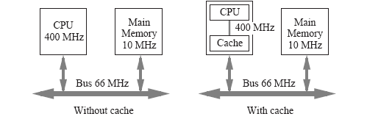
Why is cache memory fast
This cacheless computer usually needs a few bus cycles to synchronize the CPU with the bus.
A cache memory can be positioned closer to the CPU.

Slide 7
PERFORMANCE OF CACHE
Cache Memory
Memory Access
All the memory accesses are directed first to Cache
If the word is in Cache; Access cache to provide it to CPU
If the word is not in Cache; Bring a block (or a line) including
that word to replace a block now in Cache
- How can we know if the word that is required
is there ?
- If a new block is to replace one of the old blocks,
which one should we choose ?
Performance of Cache Memory System
Hit Ratio - % of memory accesses satisfied by Cache memory system
Te: Effective memory access time in Cache memory system
Tc: Cache access time
Tm: Main memory access time
T_{e} = hT_{c} + (1 - h) T_{m}
Example: T_{c} = 0.4 μs, T_{m} = 1.2μs, h = 0.85
T_{e} = 0.85 x 0.4 + (1 - 0.85) x 1.2 = 0.52 μs

Slide 8
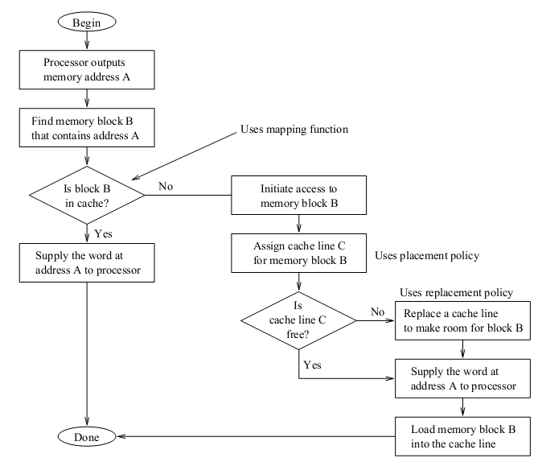
Data Reading from Memory with Cache

Slide 9


